Slide 1
01- Welcome to Airflow

Slide 2
What you will learn in this course 🧐🧐
Welcome aboard for a magnificent journey to learn how to automate your data science pipelines.
At the beginning of this journey we are going to setup all our Airflow environment to run it on your local machine. Let's get on board with:
Setup Airflow
Run your first workflow!
We are pleased to have you 🧑‍✈️, so without losing another second, fasten your seatbelt, and be prepared for the take off. 🛫

Slide 3
Setup Airflow
You have two main ways to setup Airflow:
using pip,
with docker-compose.
We are going to use docker-compose for this course because it is less prone to OS specific issues. And you are Docker experts now!
The community has done tremendous efforts to provide a really good docker-compose experience. The documentation is certainly worth a read, but we are going to review step by step the installation process.
First you need to check if you have Docker installed and running. Check if docker-compose is installed too.

Slide 4
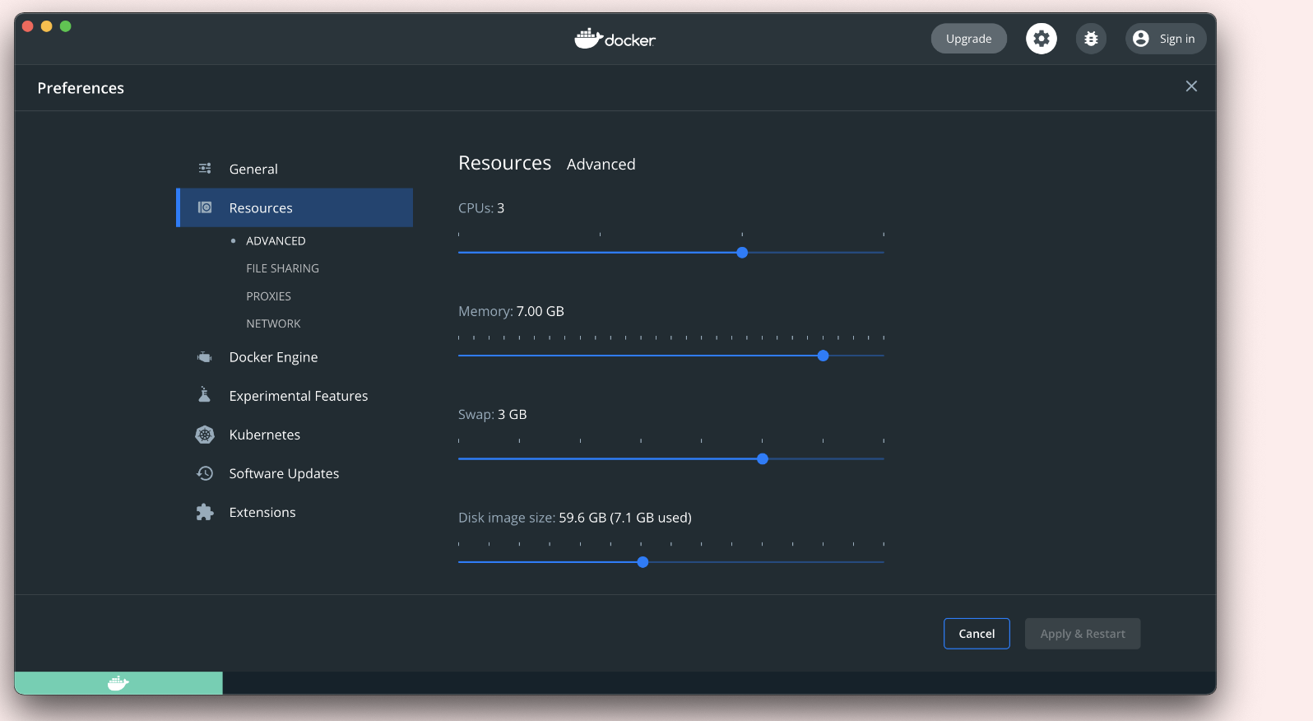
Setup Airflow
MACOS USERS!
For MacOS users, you need to be sure that Docker can allocate at least 4GB of RAM. To change that, go to the Docker preferences and in Resources you can increase the Memory limit. Set it up to at least 4GB.

Slide 5
Setup Airflow Create a new working folder. Inside this new folder, we are going to download the community predefined docker-compose.yaml file.
curl -LfO 'https://airflow.apache.org/docs/apache-airflow/2.3.2/docker-compose.yaml'
We won't go too much in detail about the docker-compose.yaml file. We will see later a bit of modification you can do to personalize it for your needs. We need to create three folders that are mounted in the docker-compose.yaml file:
$ mkdir ./dags ./logs ./plugins
Airflow needs to setup the database before using it. Simply launch:
$ docker-compose up airflow-init We are now ready to launch the Airflow server:
$ docker-compose up

Slide 6
Setup Airflow LINUX USERS!
For Linux users, there are some caveats with user privileges. You need to setup some folder by hand and create a .env file so as to give Airflow your UID (user ID). Simply run:
$ mkdir ./dags ./logs ./plugins
$ echo -e "AIRFLOW_UID=$(id -u)" > .env
That's all!

Slide 7
Setup Airflow
If everything went well, you should see the Airflow server running and access the webserver at http://localhost:8080/.
🥳 Let's dive into the Airflow UI in the next chapter and run our first workflow!

Slide 8
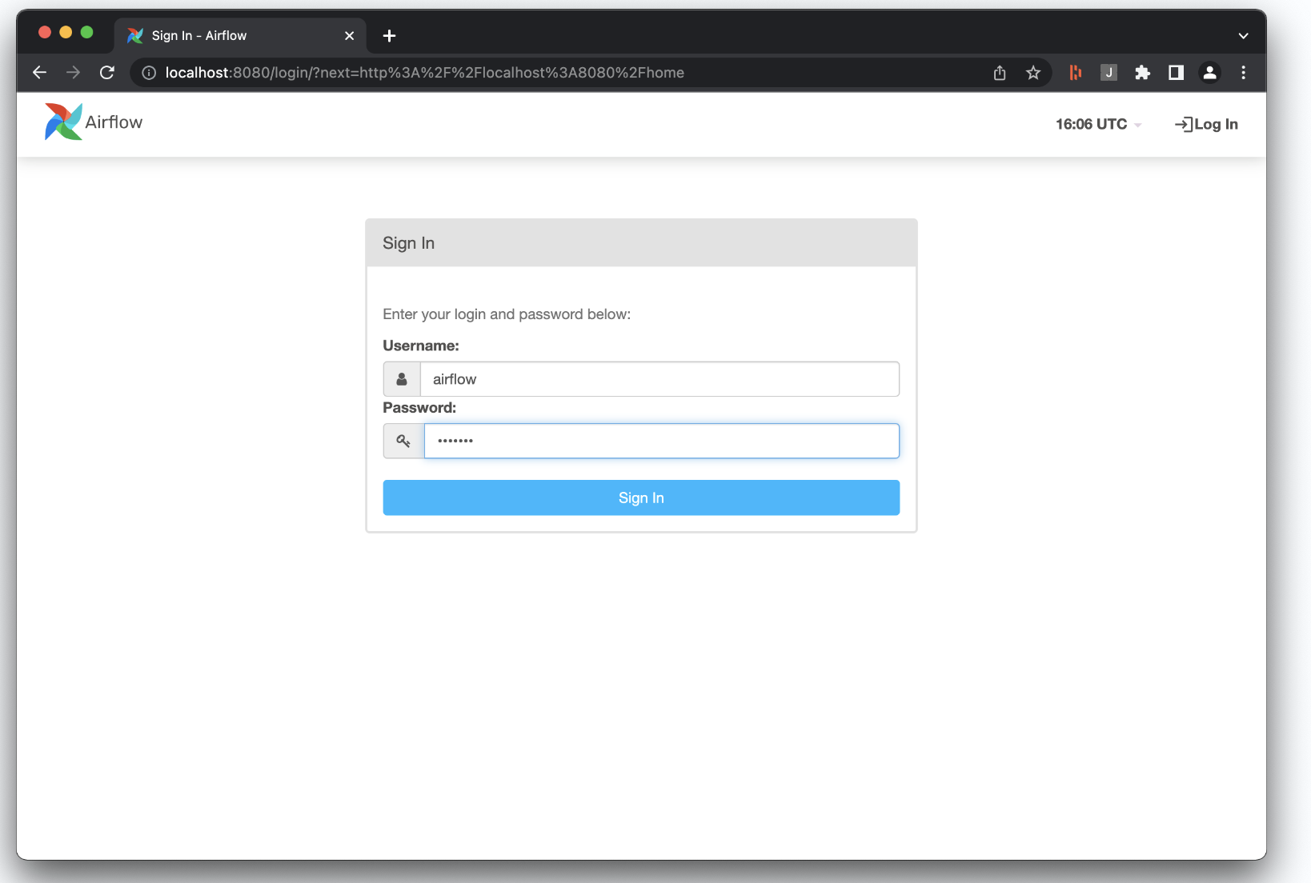
Run you first worflow!
You opened Airflow in your browser, you should see the following screen 👇 :

Slide 9
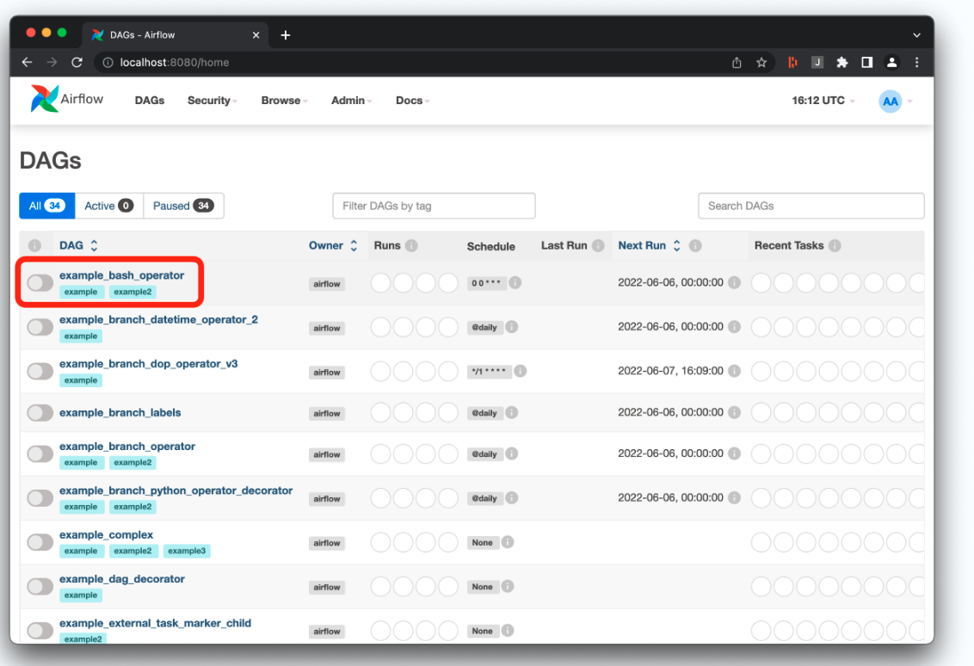
Run you first worflow!
We are not going to dive into the UI. We will explore it along the way. Let's run our first workflow using one of the predefined examples:

Slide 10
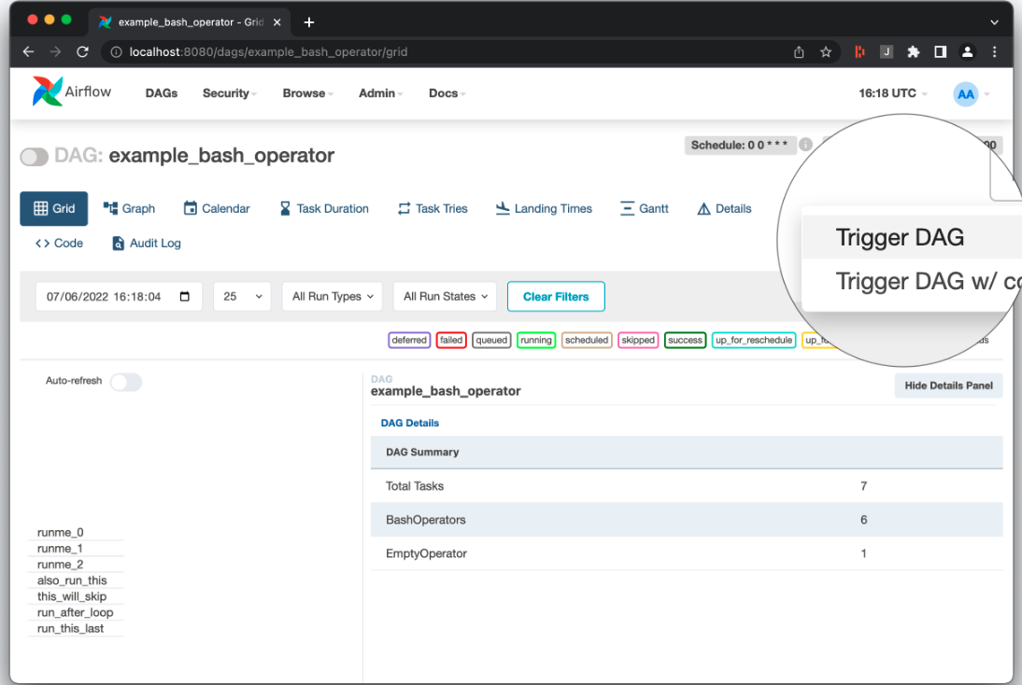
Run you first worflow!
Click on example_bash_operator. You arrive on a new dashboard, with a lot of panels. You can play a bit with them, but we will come back on some of them later on.
When you are ready to launch your first workflow, click on the play button (▶️) in the top right corner. Then select Trigger DAG

Slide 11
Run you first worflow!
The magic is happening. You should a lot of new colors changing, text appearing, and so on. The workflow is running!
Wait few seconds and voilà! You have launched your first workflow in Airflow.
You may have felt a bit lost, but don't worry, we are going to explore all this in the next lectures.

